Slide 1

July 06, 2024

Slide 2
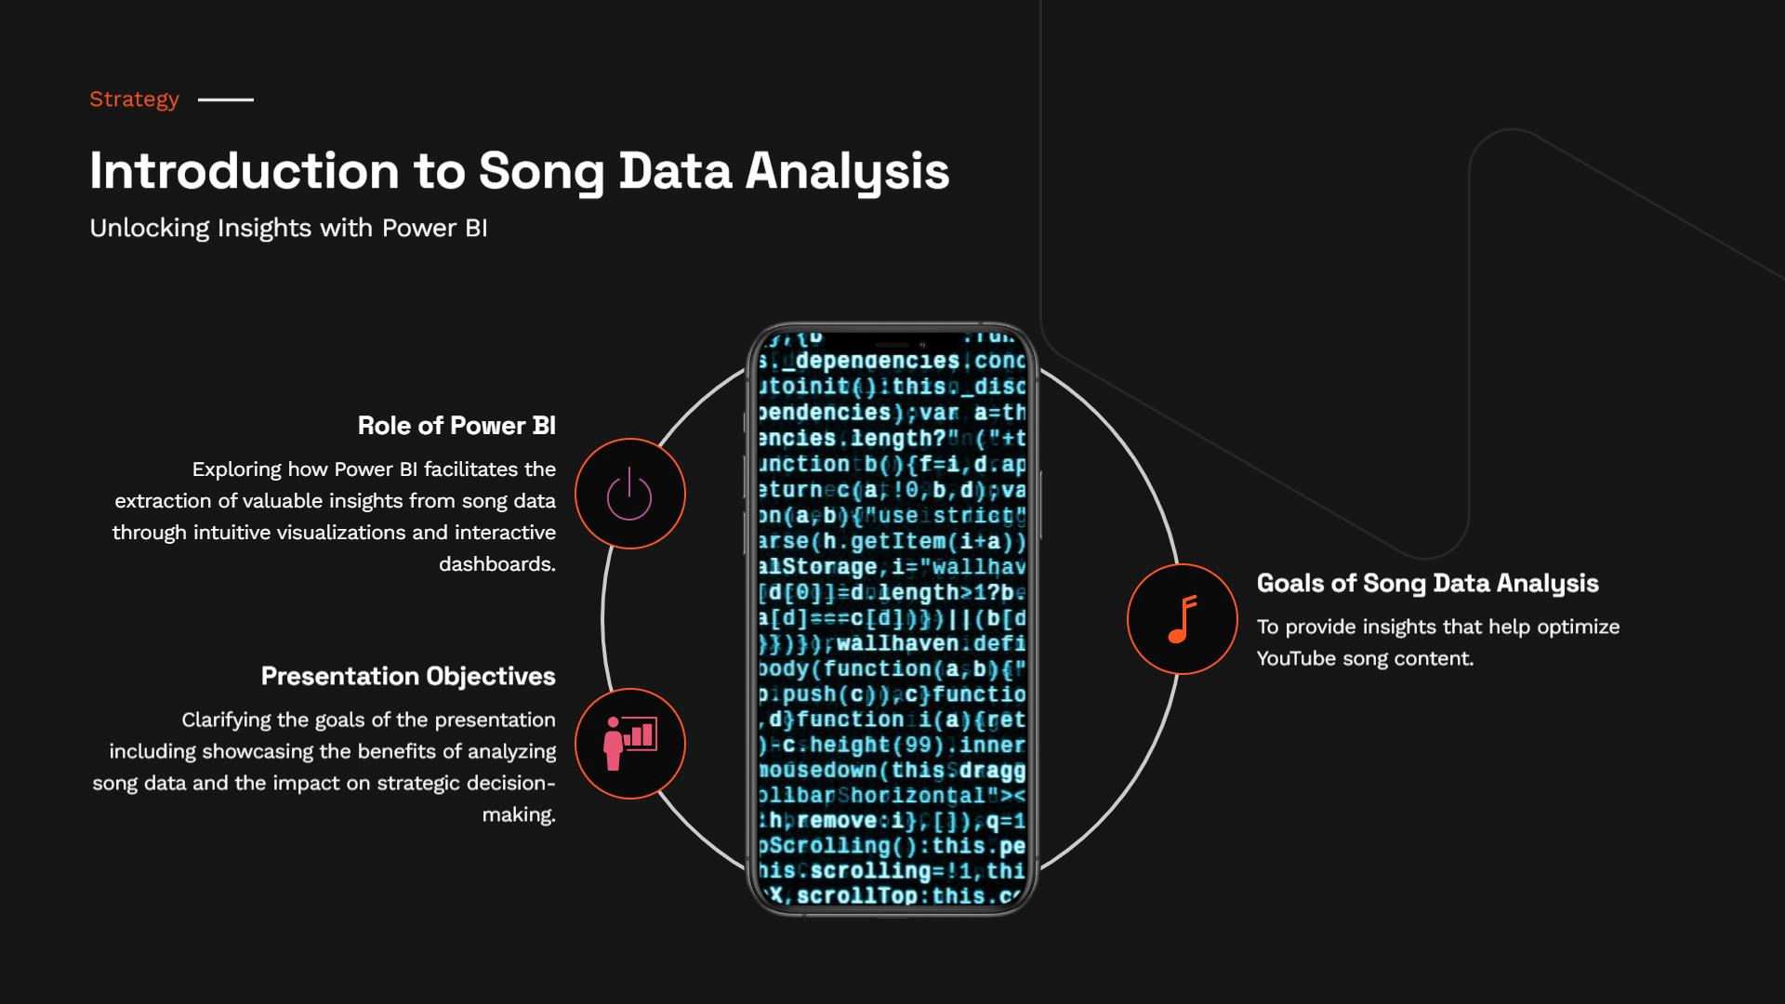

Slide 3


Slide 4
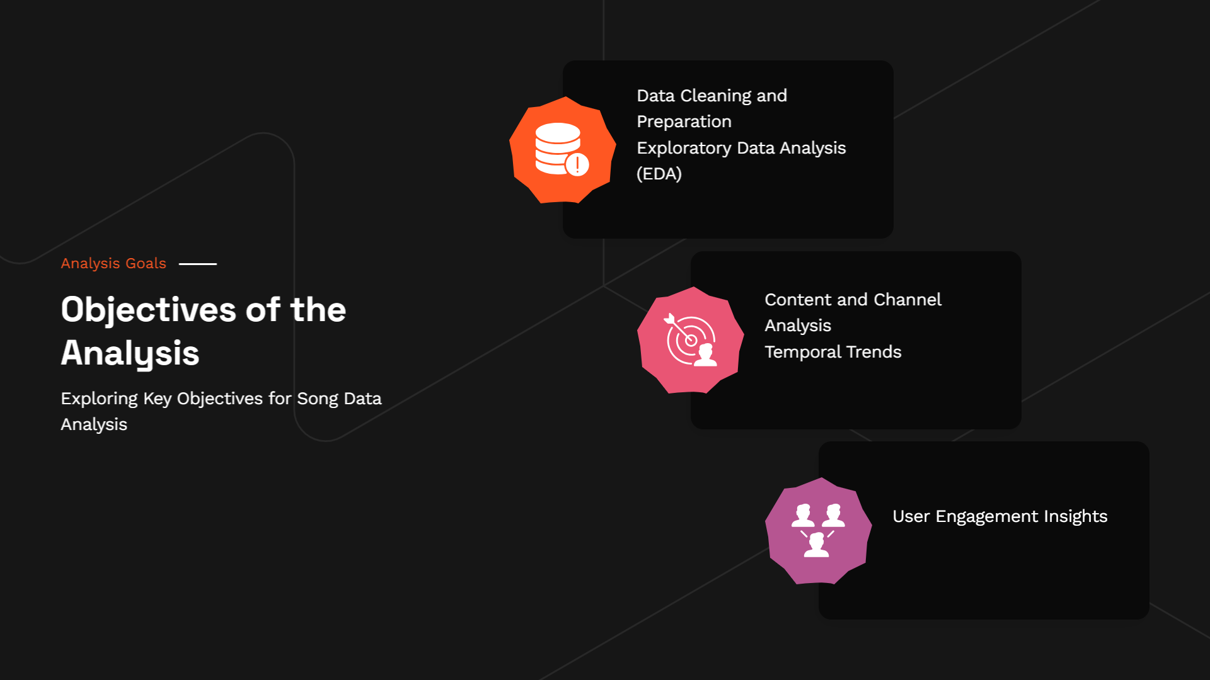

Slide 5


Slide 6
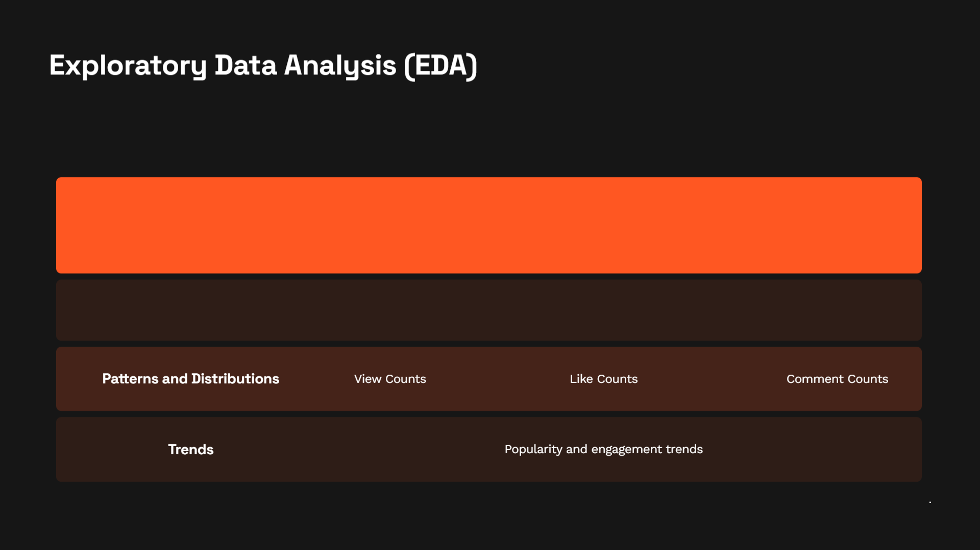

Slide 7


Slide 8
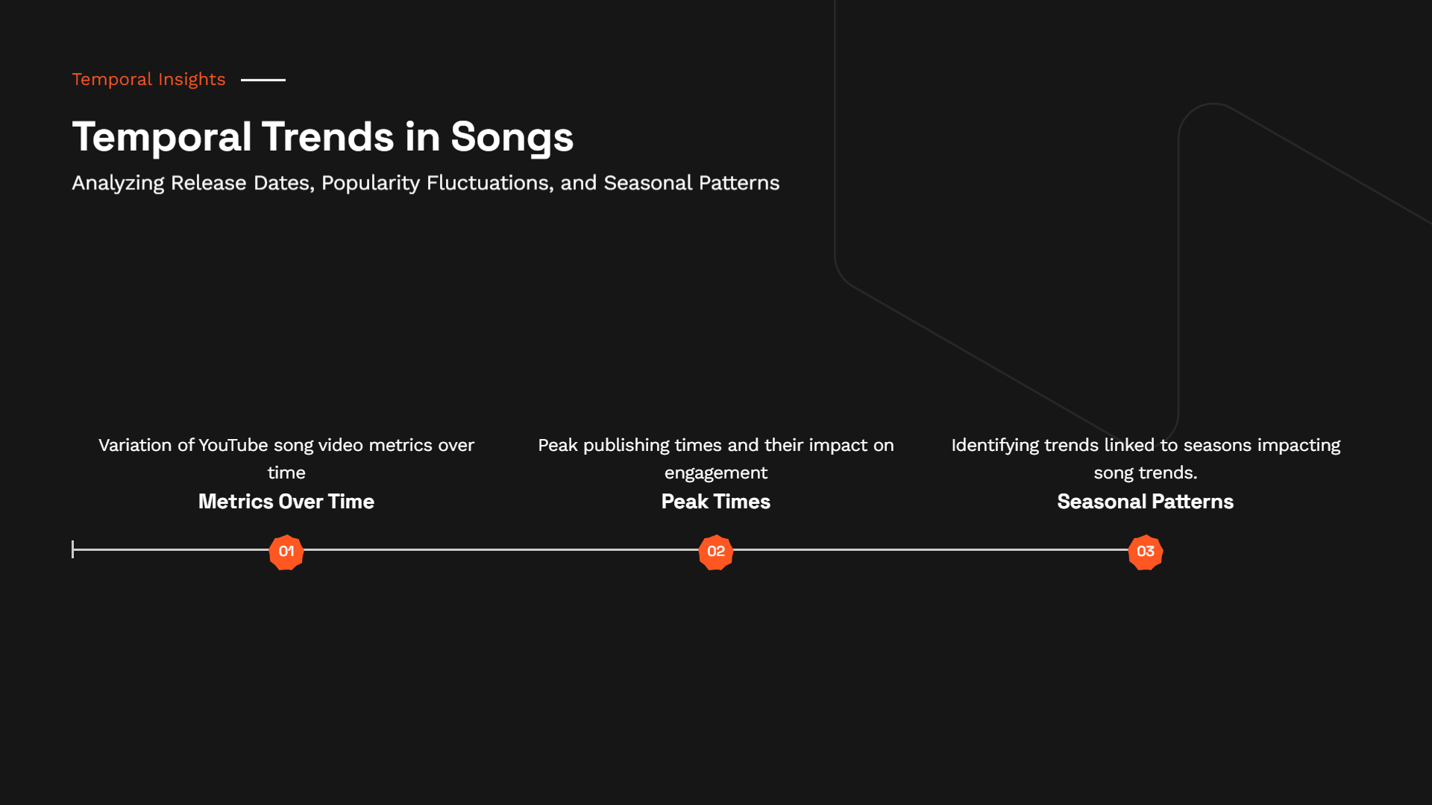

Slide 9


Slide 10
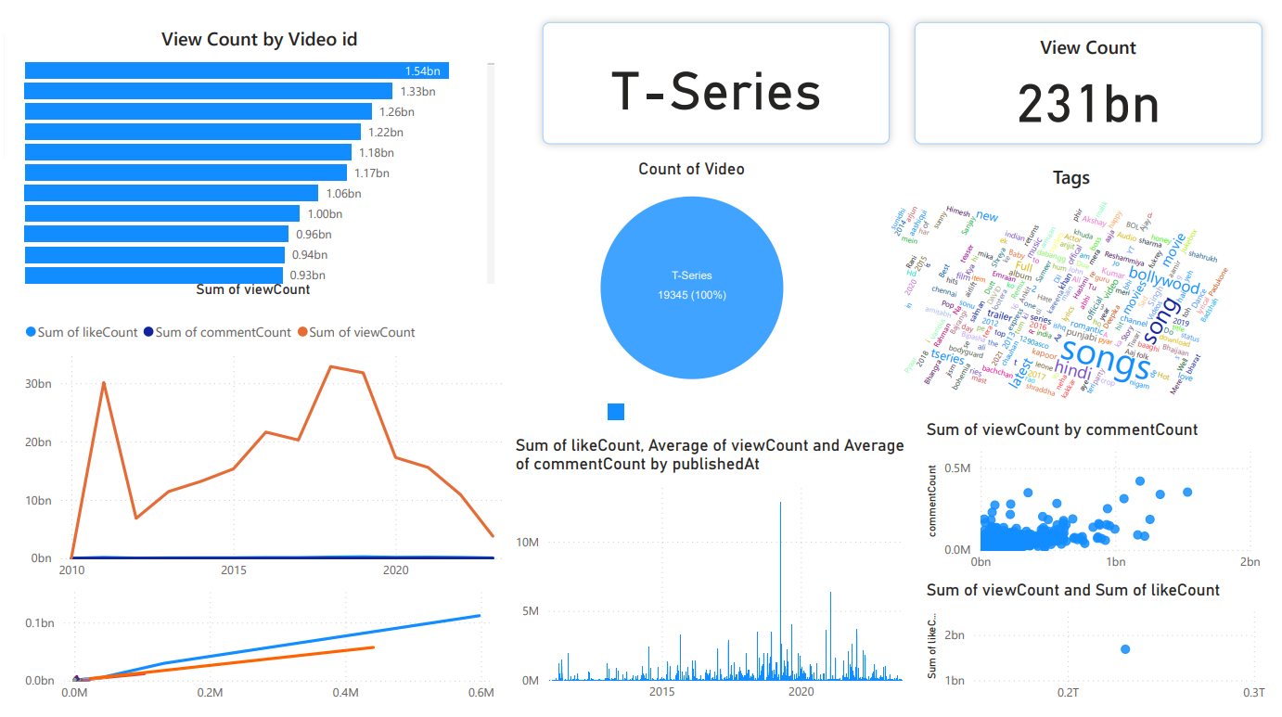


Slide 11


Slide 12






K.M. NAIMUDDIN
Batch Name: MIP-DA-10
(+880) 1869555571
Kmnaimuddin.cse@gmail.com
k-m-naimudin
KMNaim

